Slide 1

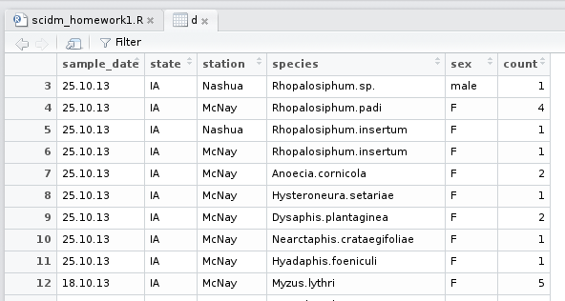
Step 1: Import data

Slide 2



Step 2: Examine column values
Check data values:
Check for missing values:

Slide 3

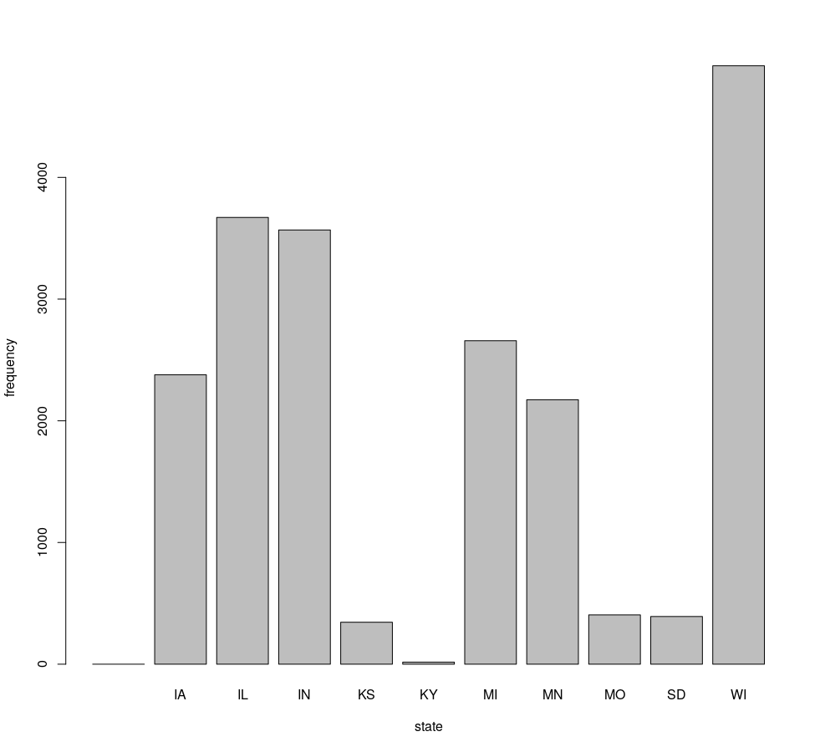
Step 3: Plot column values

Slide 4



Step 4: Harmonize column values

